Slide 1
Smart Billionaires
Team Members: Josue Mirtil Product Owner:
Instructor: Masoud Sadjadi School of Computing and Information Sciences Florida International University
Final Presentation
Summer 2017
The logo of your project
Notes:
7 seconds.( I will select 2 best slides (i will give them extra points and students will present for CIS committee)
Greet your audience, thank them for attending your presentation, introduce yourself, introduce your project, introduce your team members, and quickly indicate what each of you did in a high-level manner, and put more emphasis on your part/contribution.

Slide 2
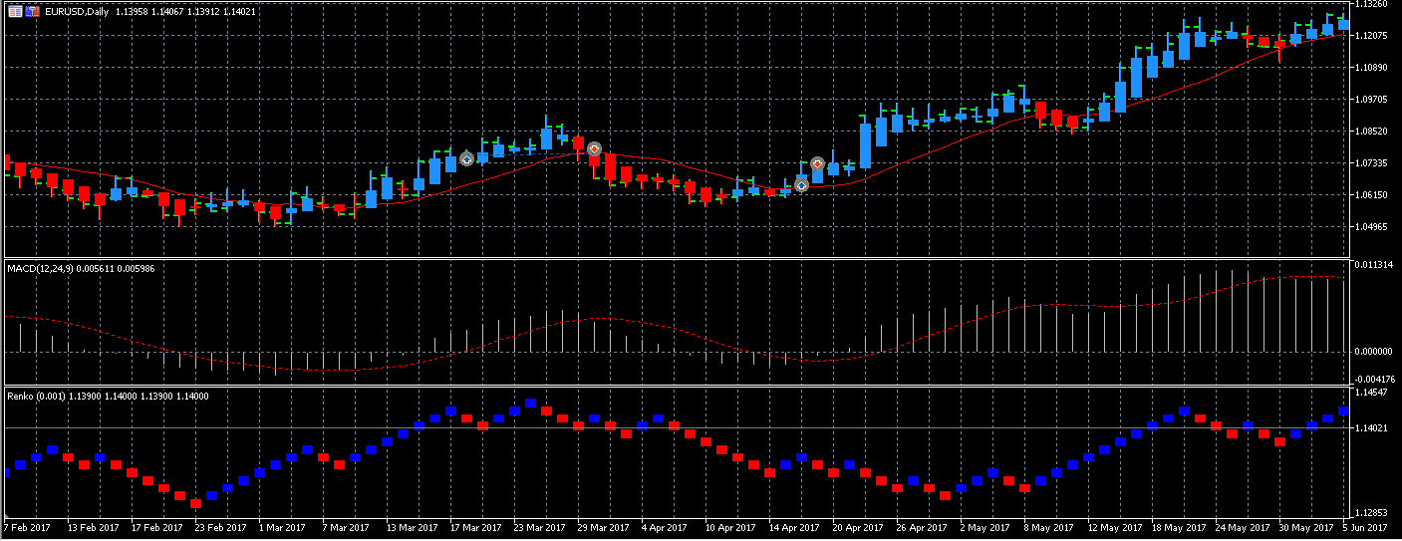
Project definition
An expert adviser that trades according to the Zone Recovery algorithm created by Joseph Nemeth.
Provide a signal that can read the Heiken Ashi, EMA, Renko, and MACD charts
Notes:
10 seconds.
Introduce the problem that the whole project (in all versions) tackles with GIF or screenshot.

Slide 3
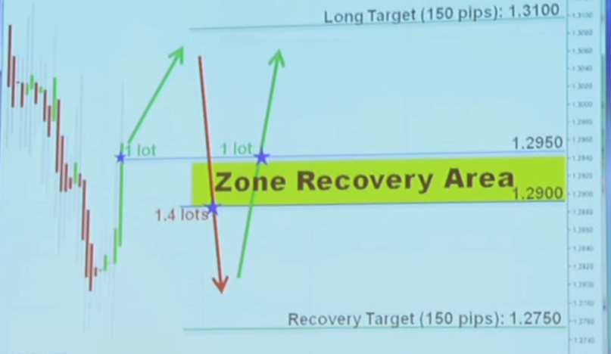
Project definition
Use the zone recovery to counter losses in the event that the prediction of when to enter the market is wrong.
Recovery Zone Area - an area in which the boundaries are the threshold to open an opposite trade.
Notes:
20 seconds.
Introduce the problem that the your project (in new version) tackles with GIF or screenshot.

Slide 4
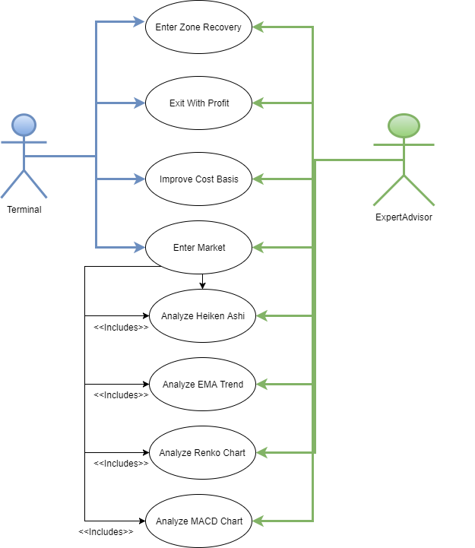
Requirements: Use Cases
Notes:
5 seconds
Show the Use Case Diagram for the whole project. Highlight your use cases.

Slide 5
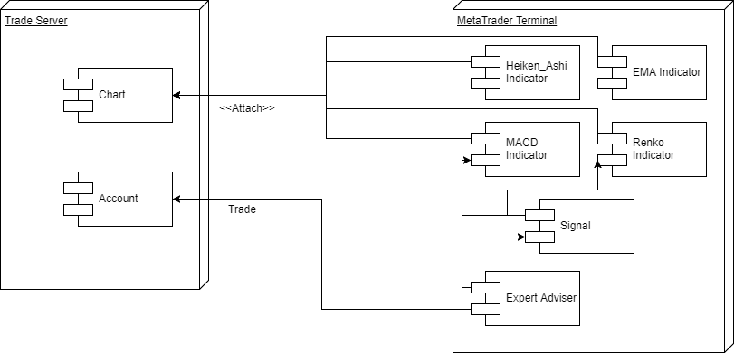
System Design: Architecture
MQL5 programs are Event Driven
Notes:
20 seconds
System design: Highlight the parts that you contributed to them.
1. System decomposition; identify the architecture patterns used
2. System deployment – h/w and s/w requirements

Slide 6
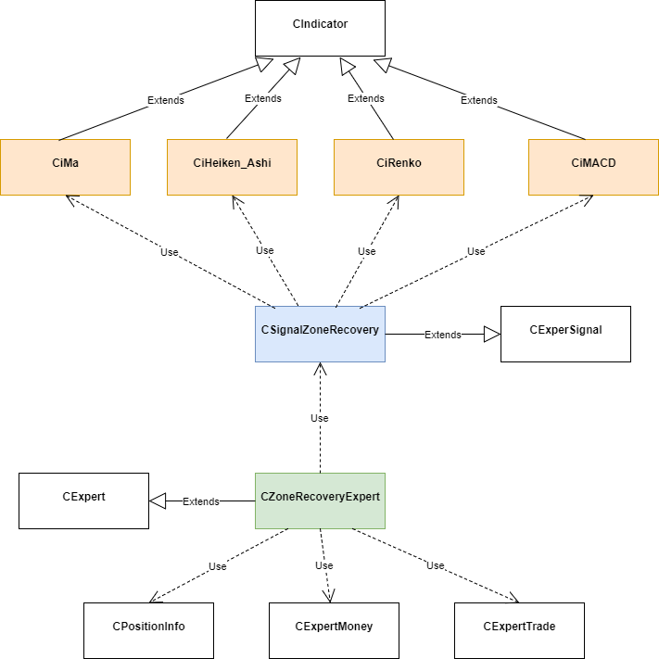
Minimal Class Diagram
Notes:
10 seconds.Minimal class diagram. Highlight the classes that you created/modified
Identify the design patterns used (one or more slides).

Slide 7
User Stories
Implement Zone Recovery
Implement Entry Condition Check
Implement Exit Criteria
Implement Indicators for Heiken Ashi
Implement Indicators for MACD
Notes:
5 seconds.
List the user stories that you worked on them.(put in order of importance). Stay focused on the parts that you have been working.

Slide 8
Implement Zone Recovery
As an expert adviser, I want to use the recovery zone so that I can open opposite trades and counter losses.
Acceptance Criteria
Given the market is expected to go up, when the market goes down past the recovery zone, then the adviser opens a short position.
Given the market is expected to go down, when the market goes up past the recovery zone, then the adviser opens a long position.
Given a target price, when market reaches the target, the adviser closes the entire position
Notes:
60 seconds
The tile of user story
The most important user story you worked on it. You have to describe this one very well and be proud of that.
Please present and show the complexity of your work, code, algorithms, and technical challenges and technologies you have used. (you could use screenshot if you want. Visual presentations are better than text presentation)
Go into the details of the most important/significant tasks using bullet lists or visual graphs or state chart diagram
Sequence Diagram for this user story is mandatory (in another separate page if required)
Demo using screenshots or GIF (in another separate page if required)

Slide 9
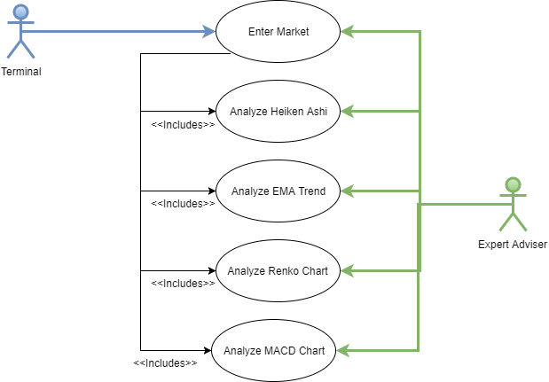
Implement Entry Condition Check
Heiken Ashi bar must be green
Slope on EMA Trend must be positive
Renko bar must be green validated by the MACD chart.
Notes:
20 seconds
The tile of user story
Please present and show the complexity of your work, code, algorithms, and technical challenges and technologies you have used. (you could use screenshot if you want. Visual presentations are better than text presentation) - Go into the details of the most important/significant tasks using bullet lists or visual graphs or state chart diagram - Demo using screenshots or GIF (in another separate page if required)
Sequence Diagram for this user story is optional

Slide 10
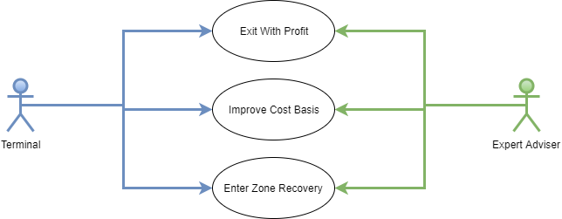
Implement Exit Criteria
As an expert adviser, I want to read the Renko charts so that I can determine when to close the position.
Notes:
20 seconds
The tile of user story
Please present and show the complexity of your work, code, algorithms, and technical challenges and technologies you have used. (you could use screenshot if you want. Visual presentations are better than text presentation) - Go into the details of the most important/significant tasks using bullet lists or visual graphs or state chart diagram - Demo using screenshots or GIF (in another separate page if required)
Sequence Diagram for this user story is optional

Slide 11

Implement Indicators for Heiken_Ashi
As an Expert Adviser, I would like to read the bar on the Heiken Ashi chart so that I can determine Market trend
Notes:
20 seconds
The tile of user story
Please present and show the complexity of your work, code, algorithms, and technical challenges and technologies you have used. (you could use screenshot if you want. Visual presentations are better than text presentation) - Go into the details of the most important/significant tasks using bullet lists or visual graphs or state chart diagram - Demo using screenshots or GIF (in another separate page if required)
Sequence Diagram for this user story is optional

Slide 12

Implement Indicators for Renko
As an Expert Adviser, I would like to read the bar on the Renko chart so that I can determine Market trend
Notes:
20 seconds
The tile of user story
Please present and show the complexity of your work, code, algorithms, and technical challenges and technologies you have used. (you could use screenshot if you want. Visual presentations are better than text presentation) - Go into the details of the most important/significant tasks using bullet lists or visual graphs or state chart diagram - Demo using screenshots or GIF (in another separate page if required)
Sequence Diagram for this user story is optional

Slide 13
Test Suites and Test Cases
Exploratory testing was the main process of verification with MetaTrader’s Strategy Tester.
Test Cases:
Inputs: All four charts signal market is up; Expected output: Open long position; Results: Success
Inputs: Heiken Ashi signals the bar is red; Expected output: No trades open; Results: Success
Inputs: Renko signals the bar is red; Expected output: No trades open; Results: Success
Notes:
10 seconds
A description of verification process and Test Suites and Test Cases for one of the use cases.
1 One sunny day and one rainy day for the implemented use cases (one or more slides).
2 Automated test scripts for the implemented use cases (if any) (one or more slides).

Slide 14


Summary
Stories mentioned were all the stories created for the project. All of which developed by Josue Mirtil. For this project we used scrum, and held daily meetings at noon.
Questions? Contact me at jmirt001@fiu.edu
Thank You!
Notes:
10 seconds
Summarize your contribution, mention your effort for Scrum, Mingle, Github, Google Drive Documentation and minutes
Include your contact information
Ask if anyone has any questions for you.
Thank your audience

